Slide 1
Association rule Presentation
Submitted To- Submitted By-
Dr. Dharmveer Singh Rajput Rishi Bhardwaj
Parag Gagg

Slide 2
Contents
Introduction
Application
Initial Methods
Proposed Method
Future Scope

Slide 3
Application of ASOCIATION RULE
Marketing
Business
Medical Analysis
Bioinformatics
Product Control

Slide 4
INTRODUCTION
The knowledge discovered from a database can be expressed in patterns such as decision trees , clusters or association rules
OUTPUT PRIVACY : is that preventing the mining output from malicious inference attacks
INPUT PRIVACY : is that sanitizing the raw data itself before performing mining

Slide 5
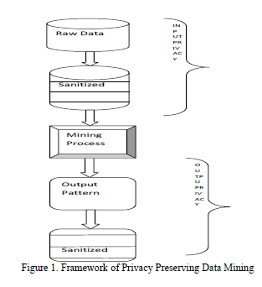

Slide 6

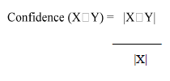
Calculate Some Parameters :

Slide 7
Apriori algorithm
The algorithm is based on the a priori hypothesis, viz., an item set can only be frequent if all its subsets are also frequent.
This information makes possible to reduce the search space efficiently when discovering the frequent item sets, because using this information reduces the number of candidates.

Slide 8
Proposed method
find the frequent items and the association rules are generated using the A priori algorithm
These rules are used to form representative association rules having frequent items on LHS
The selected RHS are considered as sensitive items
The selected RHS are considered as sensitive items

Slide 9
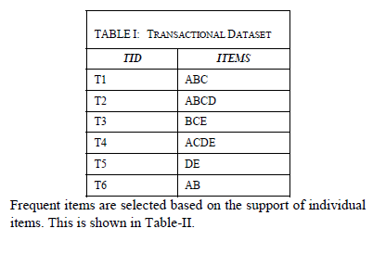

Slide 10
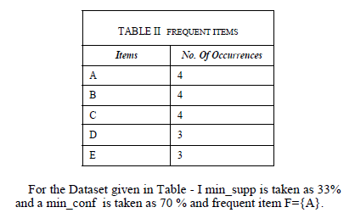

Slide 11
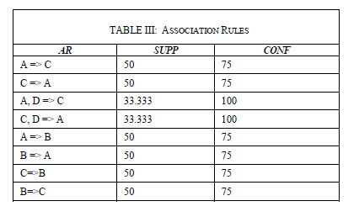

Slide 12
A=>C(50,75),
C=>A(50,75),
A,D=>C(33.33,100)
C,D=> A(33,100)
A=>B(50,75)
B=>A(50, 75).
A=>B and A=>C can be written as A=> BC

Slide 13
Future scope
Further research work is to hide the sensitive association rules using the selected sensitive items.

Slide 14
Thanks

